Slide 2
Dr Ryan Heartfield, CISSP
Head of Cyber Security Research & Innovation
Who are we
A cybersecurity start-up specialising in AI-driven threat detection and response for smart manufacturing.
Our Mission
Making strong cybersecurity accessible to SME manufacturing companies going digital.

Slide 3
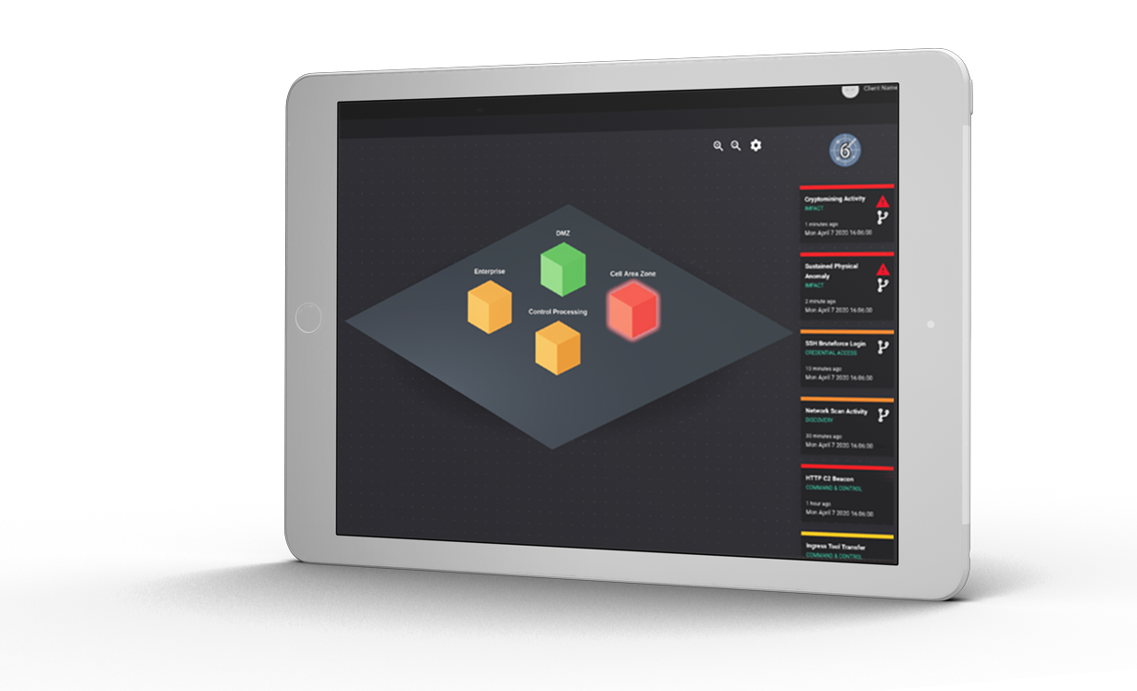
RETINA™ as the Cybersecurity Pathway to Industry 4.0
Detects cyber threats to digital machinery and automatically responds to them before their impact escalates to a safety incident, without the need for expert cyber skills or changes to infrastructure, how...
"Cyber-physical" System Visibility
Automated Threat & Early Warning Assessment
"Control-Aware" Response
Data-Upcycling

Slide 4
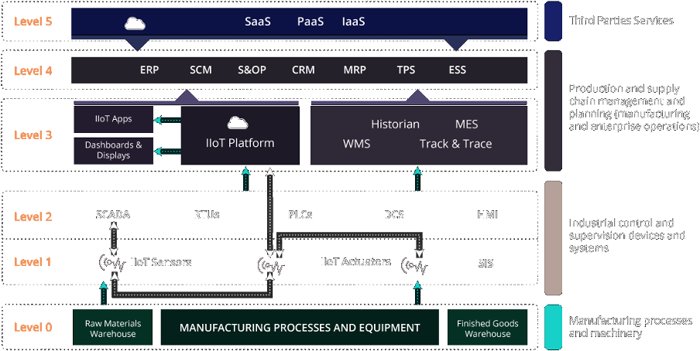
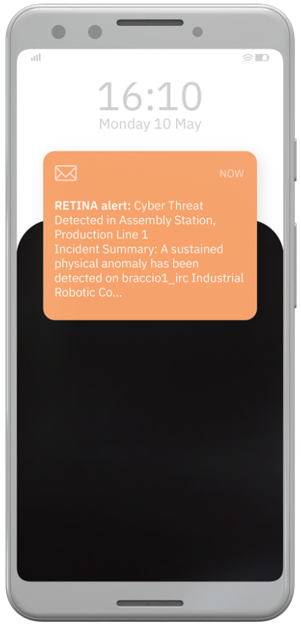
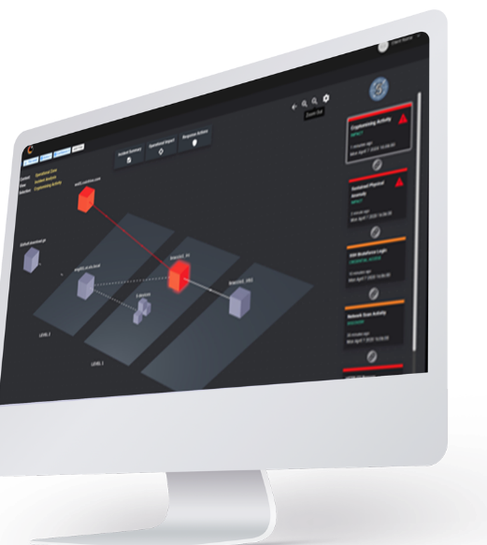
RETINA™ as-a-Service

Slide 5
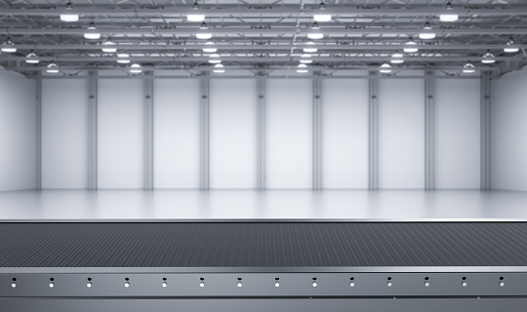
Why are we talking about cybersecurity, isn't it an "IT" thing? ...
"Waste" Bucket
"Waste" Reduction Bucket
"Value" Producing Bucket
Digital Safety Systems
Expert Resources
Protect safety of
Process Monitoring
Intellectual Property
Automation Systems
Raw Materials
Cybersecurity
Cybersecurity
Machinery

Slide 6
Revised
Purdue
Model from ENISA

Slide 7
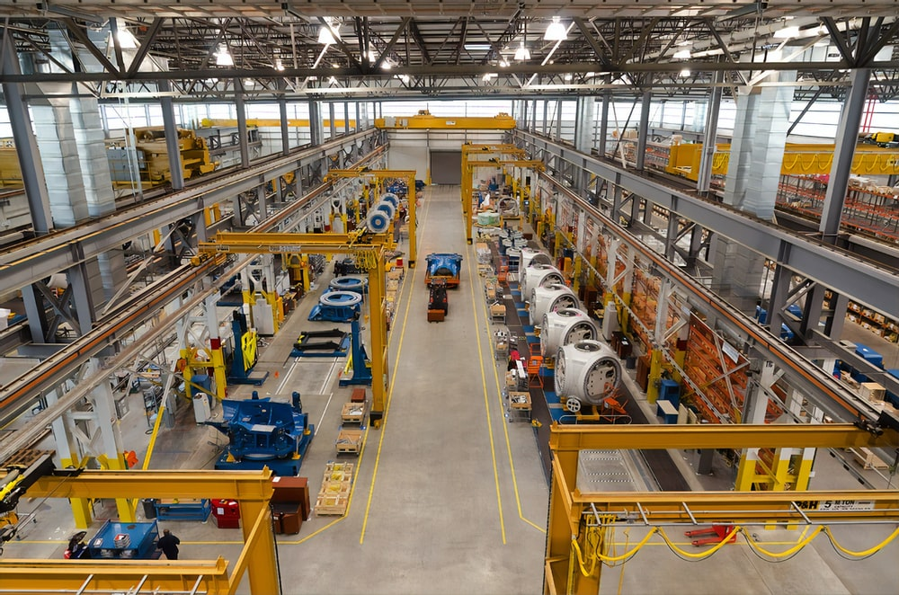
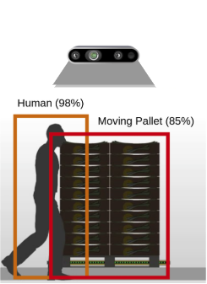
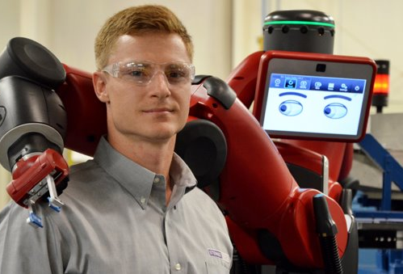
How is "smart" technology in machine safeguarding protecting workers
Combining IIoT Sensors with computer vision
Enabling Industrial "Cobots“ (Robots without cages!)

Slide 8
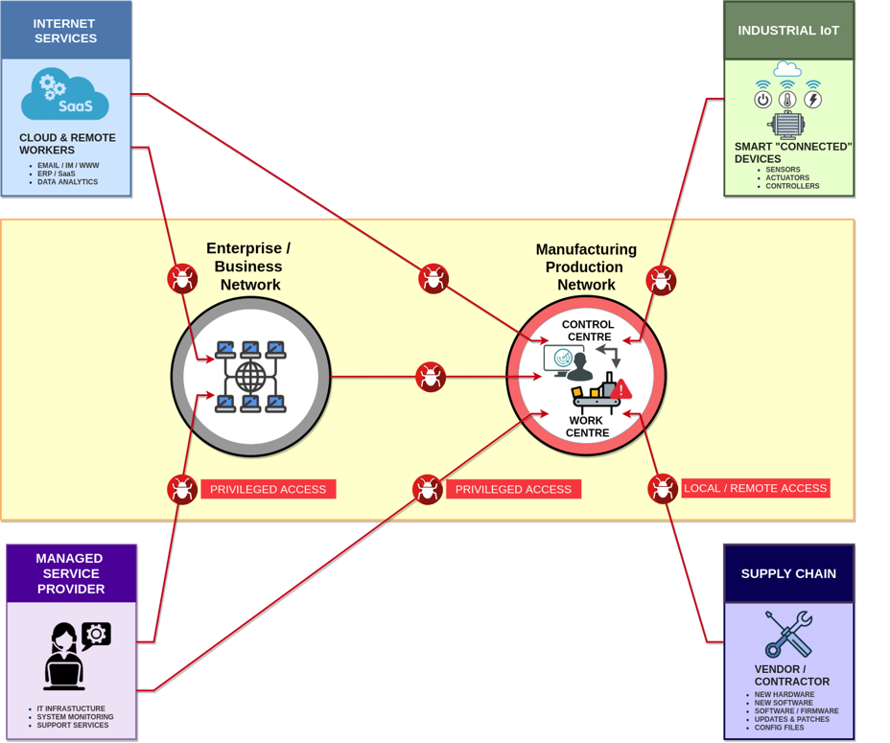
Entry Points to Production

Slide 9
Ransoming the Smart
Factory

Slide 10
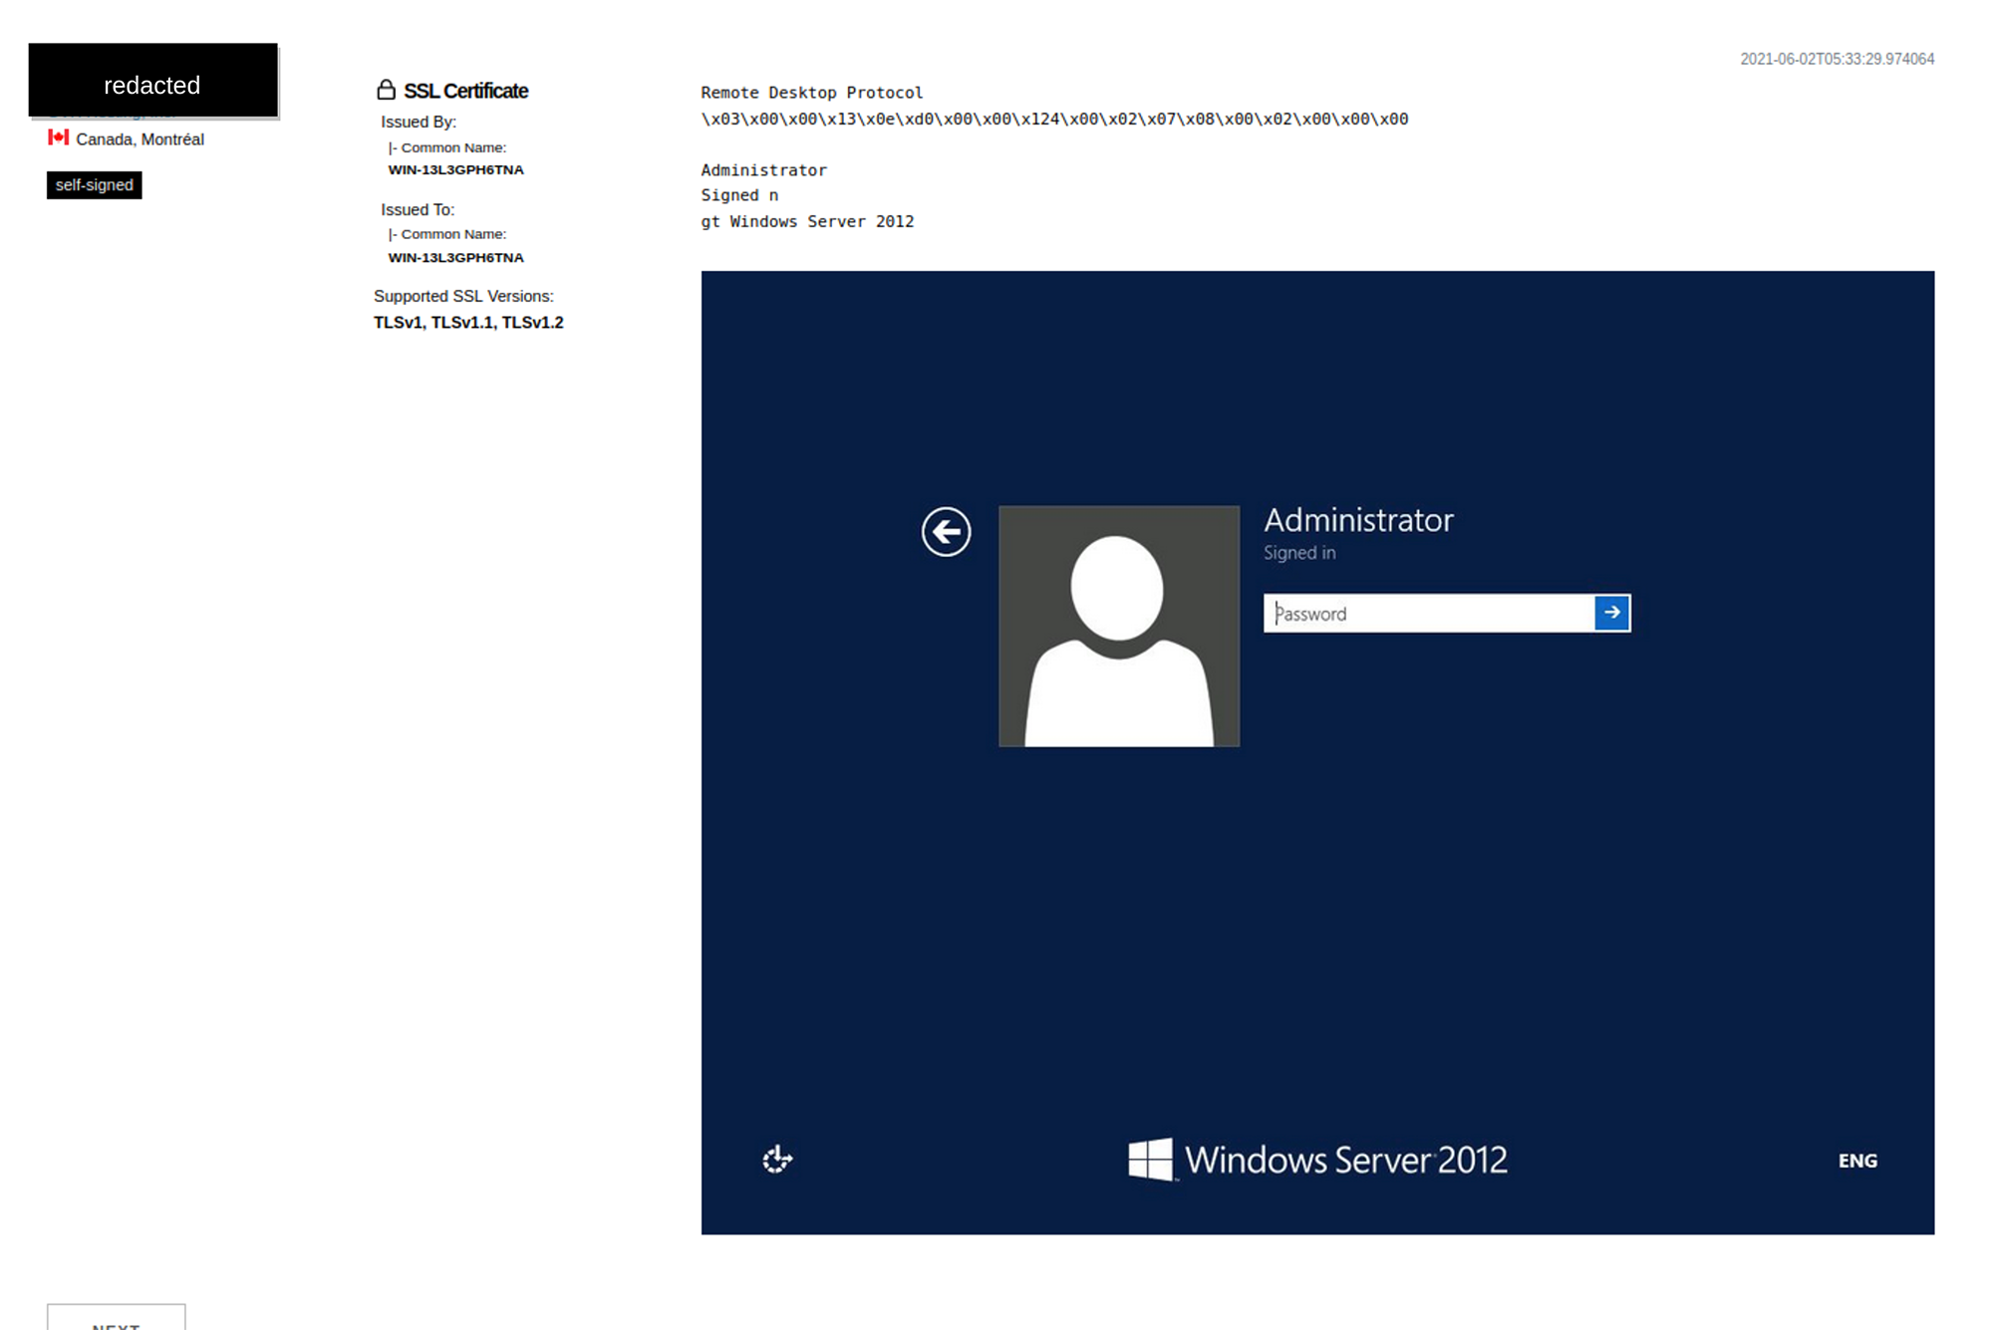
Leaving the front door open

Slide 11
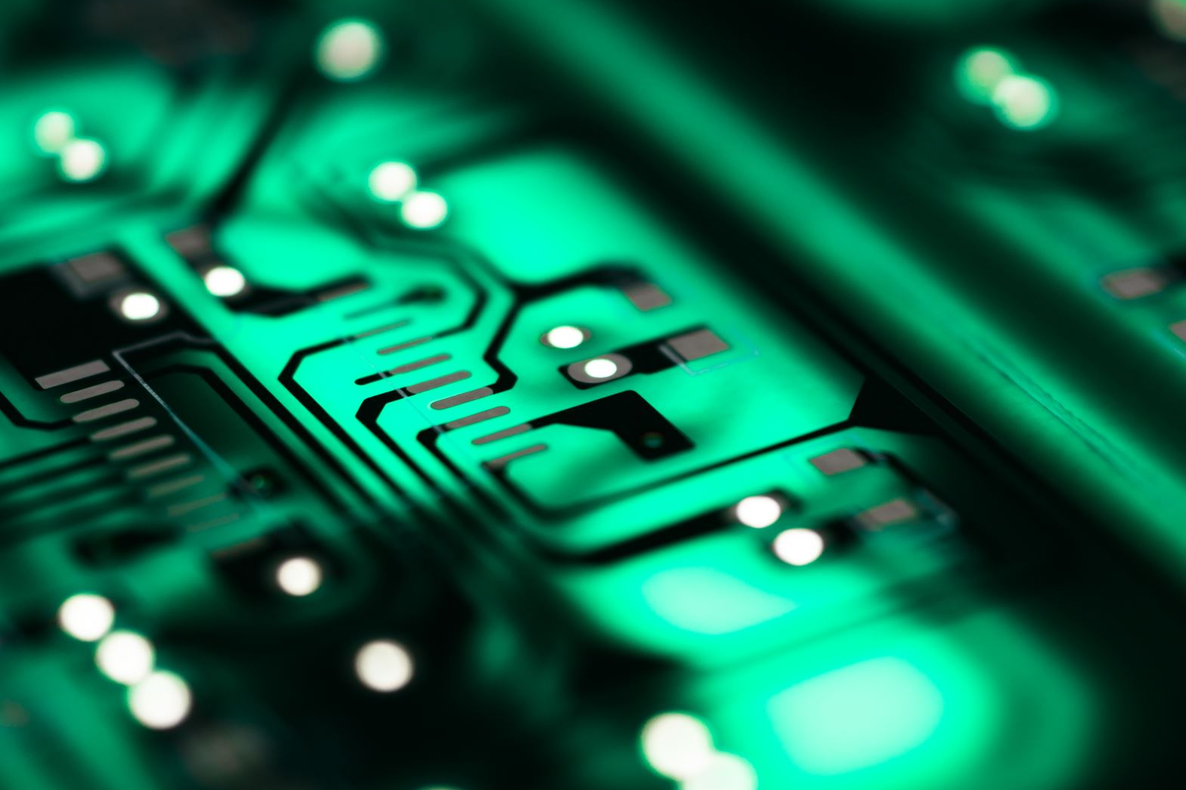
Cybersecurity starts with visibility. An initial “cyber risk profile” in ANY industry must start with the "known knowns"
1.
Become familiar with different entry points to business/production and between them (PPT)
2.
Understand different "service" connectivity
3.
Profile devices, their different roles and impact in business and production processes
4.
Have a (basic) incident response plan … (this includes the PP in PPT)

Slide 12
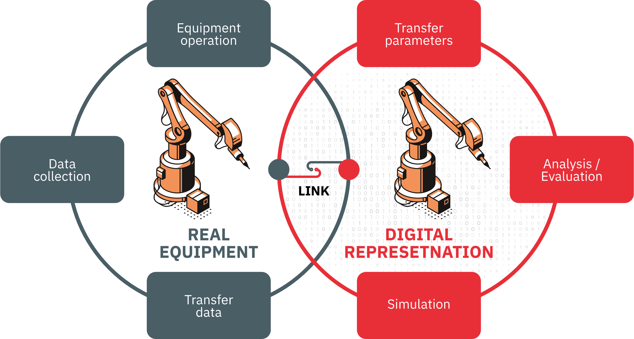
What's next... trends in IIoT & cybersecurity
5G Connectivity and "smart" automation
"Zero-Trust" Paradigm
“Cyber-physical” Situational Awareness (Digital Twins, CyTwins)

