Slide 1
Eight Trends for the Future World of Work (Omicron Edition)
February 1, 2022
Notes:
Title slide

Slide 2
Today’s Agenda
NSC Overview
How We Got Here
Eight Trends for the Future World of Work
So What?
Current State of COVID
Questions & Answers

Slide 3
National Safety Council America’s Leading Nonprofit Safety Advocate
Over a century of safety leadership; 16,000 member companies
Eliminating leading causes of preventable death and injury so that people can live their fullest lives
Focus efforts where we can make the biggest impact: workplace, roadway, impairment

Slide 4
How We Got Here
Background & Methodology
Future of Work Framework

Slide 5
Background & Methodology
Existing discussions and exploration
Emerging topics/benchmarking
Campbell Institute
Work to Zero
Acceleration due to COVID-19
Reflections on change management
Need to understand future state
Capturing lessons learned
Mixed-Method Approach
Multiple surveys across since summer/fall 2020
Dozens of benchmarking sessions
Hundreds of conversations

Slide 6
Framework: Navigating the Future World of Work
Work Modalities
Worker Expectations
Work Enablers
Remote Work
Flex Schedules
Consistent Comms
Stress/ Mental Health
Safety & Health
Cross-functional Teams
Reduced Occupancy
Travel & External Engagement
Benefits & Access
Visible Actions
Mobile & Video Technology
Automation, Wearables & More
Eight Trends for The Future World of Work
Lean, Distributed, Asynchronous Work Teams
New Skills & Modes of Leadership
Reduced Footprints & Enhanced Sustainability
Dramatically Increased Transparency
Safety & Health Embedded at Core
“Whole Person” Valuation
Technology as a Mandate
Thriving Internal & External Partnerships

Slide 7
8 Trends for the Future World of Work
Trend-by-trend look

Slide 9
Altered Team Dynamics
Zoom: March 1 2020/March 1 2021
Example: remote call with UK-based team
“Forced listening” vs active engagement
Unexpected Leaders
Unlocking hidden potential
Time constraints; stepping up/standing down
The Virtual Water Cooler
Leveraging an array of tools
Source: Cisco

Slide 10
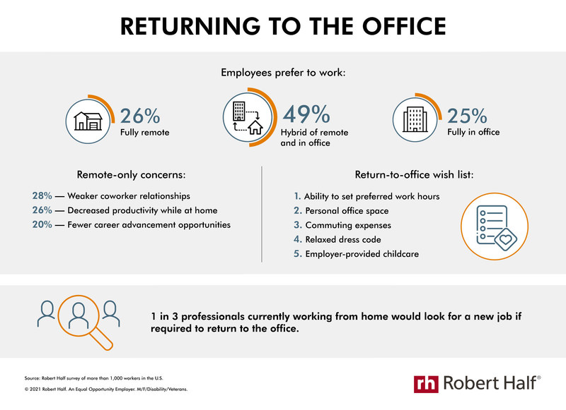

Slide 11
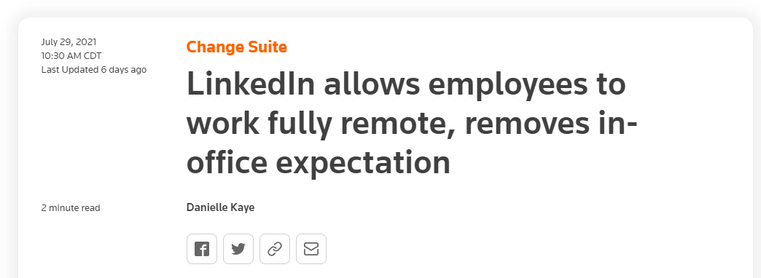
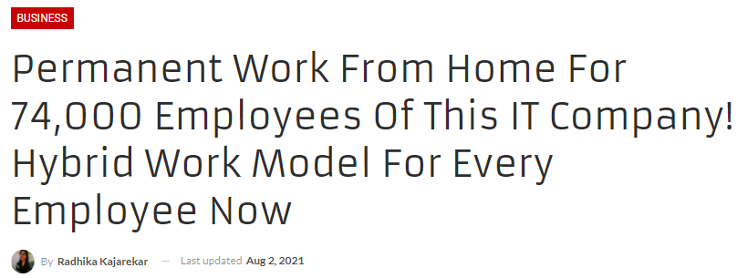
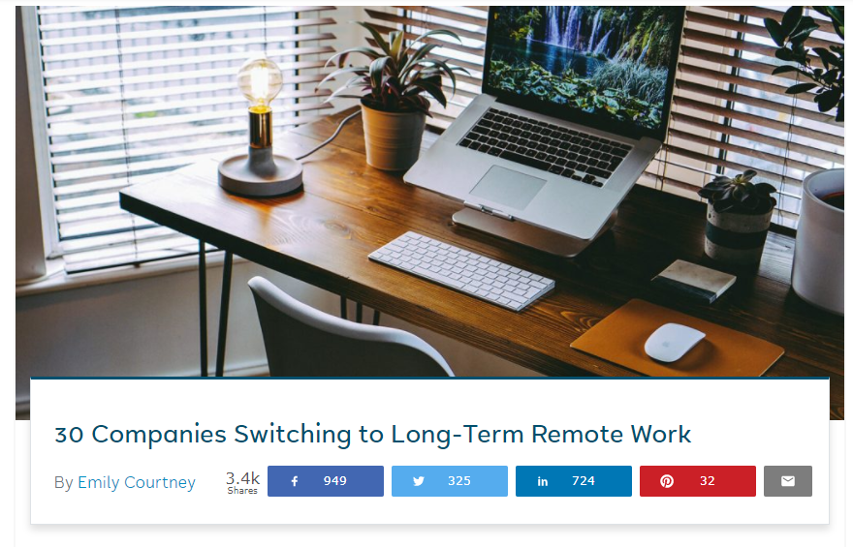
Omicron Update: Hybrid - Here to Stay

Slide 13
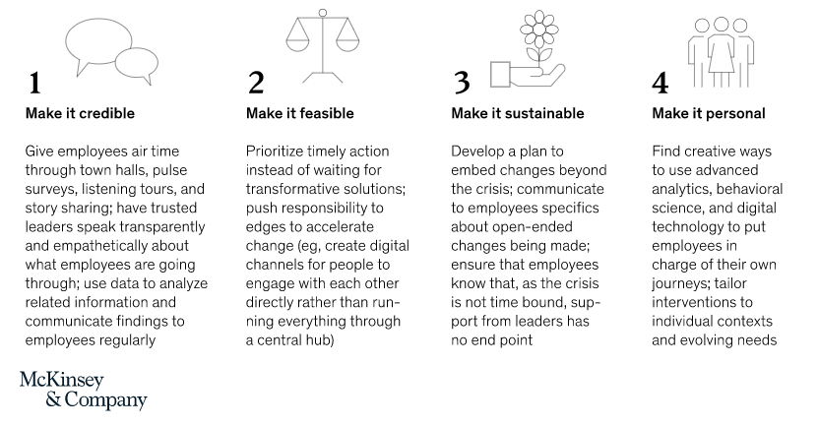
Hybrids & Habit
Lessons: New Styles of Leadership
Communicating the “why”
Valuing different perspectives
Transparency & trust
Group & individual approaches

Slide 14
Hybrids & Habit
The Power of Habit
Forming a habit: 66 days
“Post-vaccine inertia”
Acknowledging confusion & trauma

Slide 15
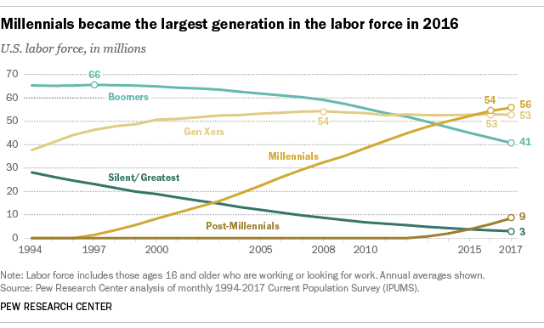

Slide 16
Omicron Update: Leadership Cognitive Biases
Normalcy Bias
Underestimating the probability or extent of expected disruption
Planning Fallacy
Underestimating the time it will take to complete a future task, despite knowledge that previous tasks have generally taken longer than planned
Ostrich Effect
Monitoring and attending to information more actively given preliminary good news but avoiding additional information given adverse prior news

Slide 19
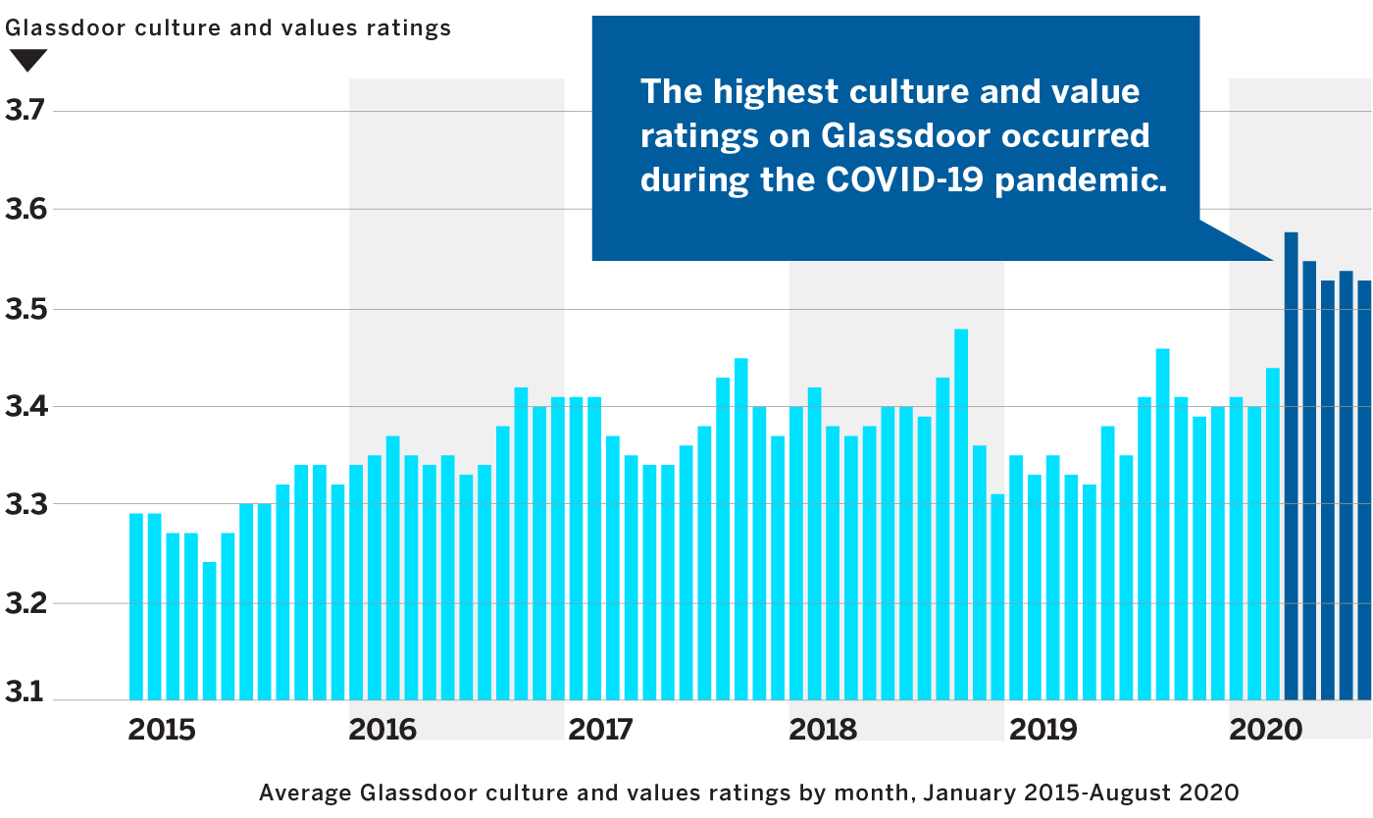
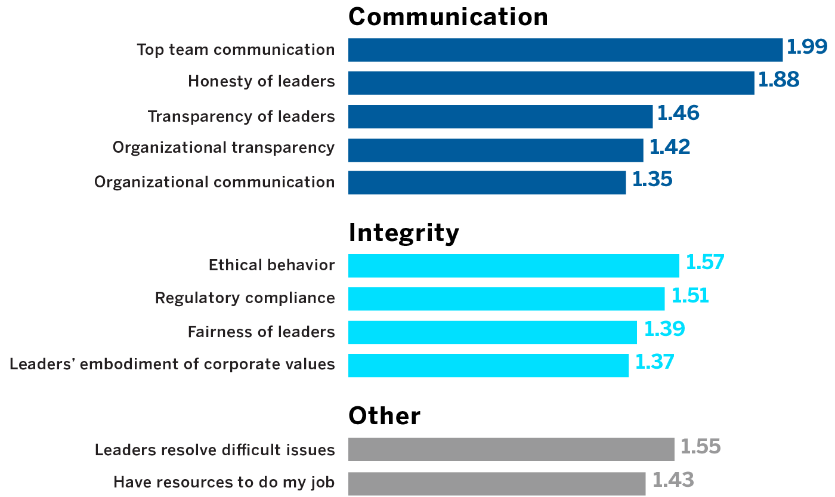
Culture, Communication & Transparency
Source: MIT Sloan Culture 500 Study

Slide 20
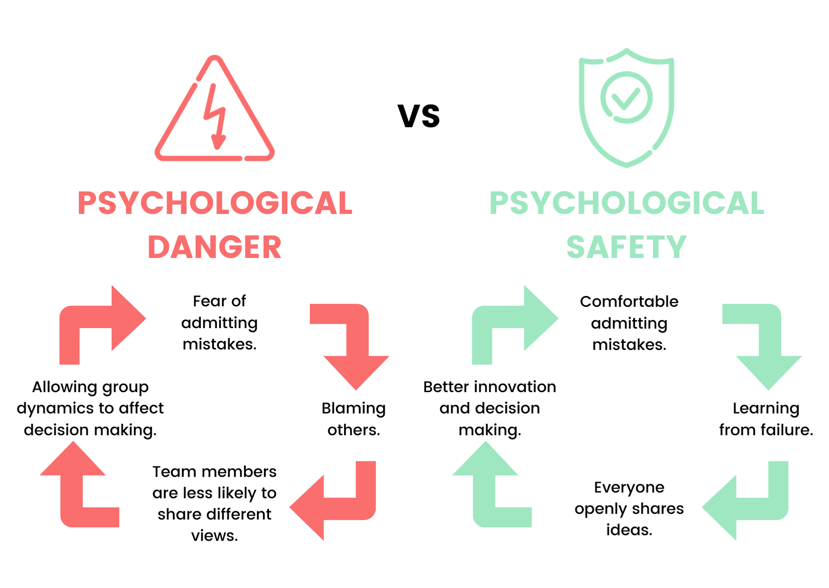
Embracing Psychological Safety
Source: Unicorn Labs

Slide 21
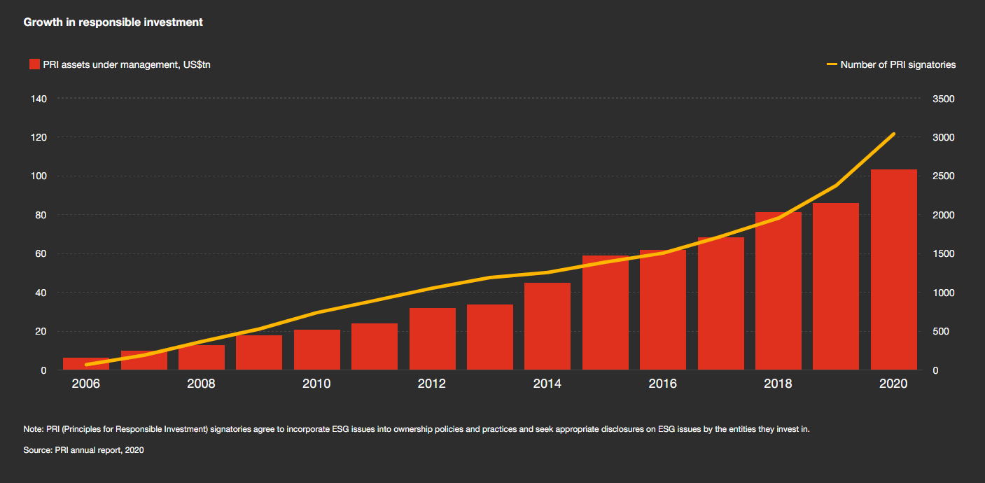
Omicron Update: Investors Agree on Transparency

Slide 23
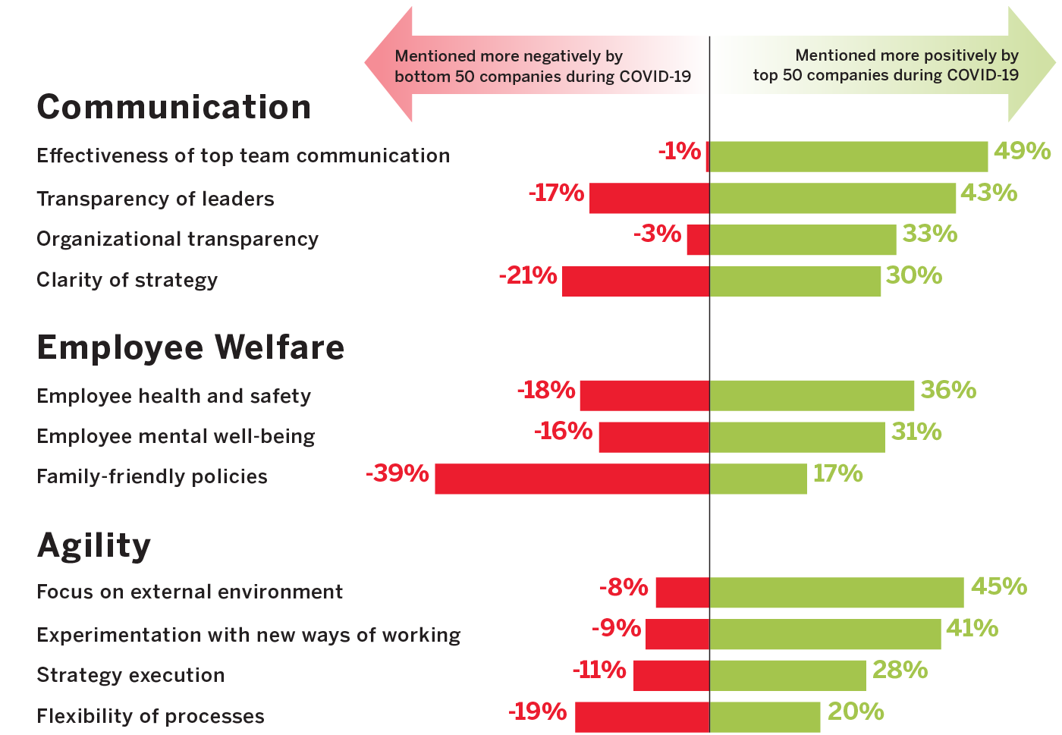
The Value of Safety & Health
Source: MIT Sloan Culture 500 Study

Slide 24
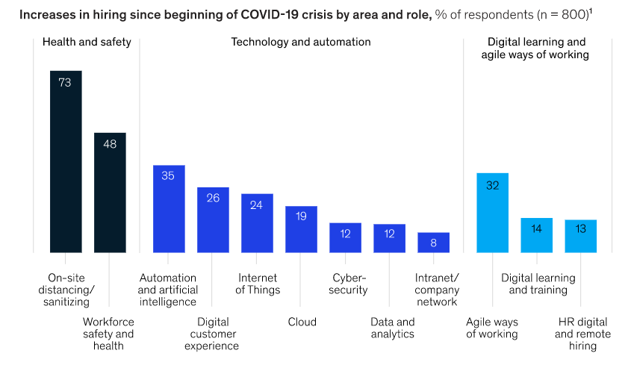
The Value of Safety & Health
Source: McKinsey

Slide 25
Omicron Update: The Long Tail of EHS Value
Ongoing need for EHS to lead the way
Mitigating change & rollercoaster effect
Maintaining “true north” value
Risk-based approaches
Overcoming “initiative fatigue”

Slide 28
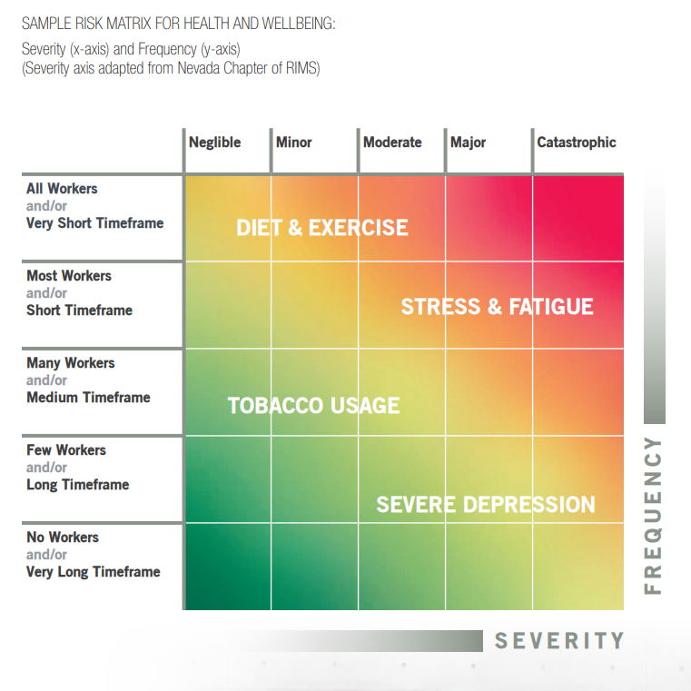
Systemic & Risk-Based Wellbeing

Slide 29
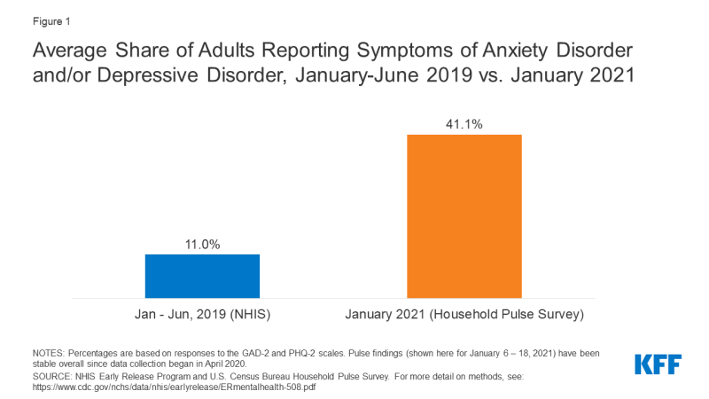
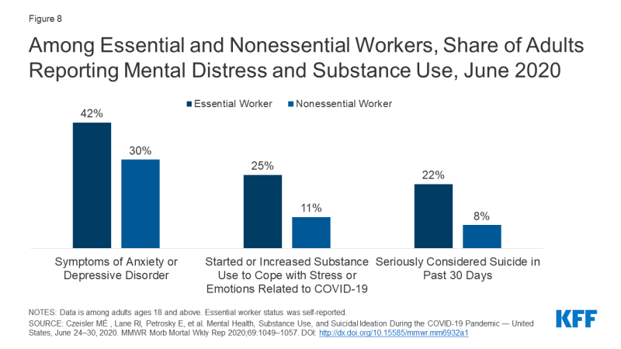
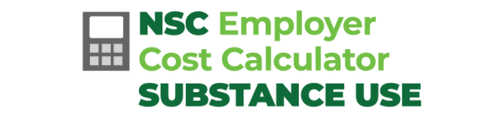
Focus on Mental Health

Slide 30
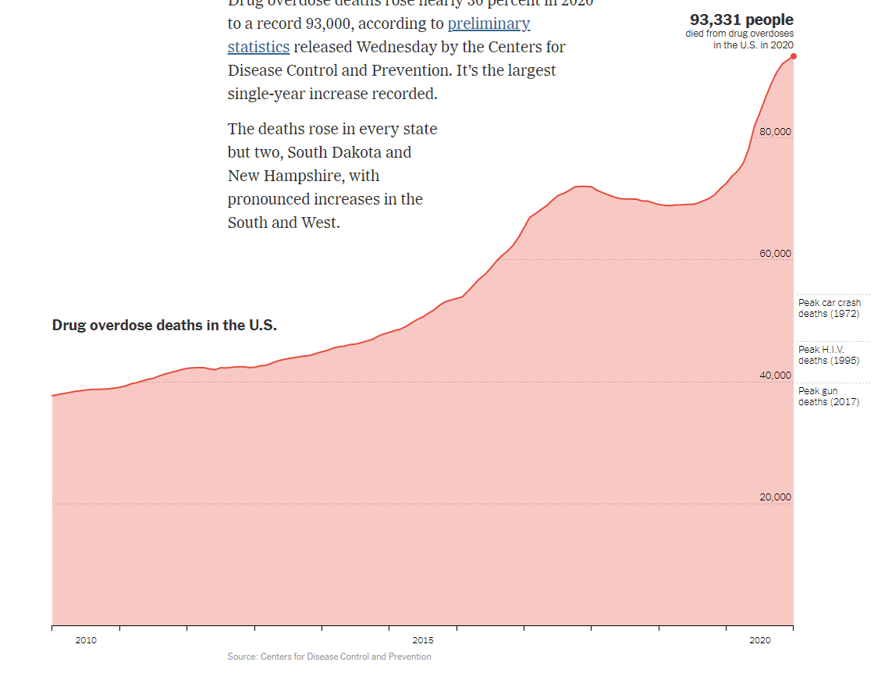
Omicron Update: Staggering Numbers

Slide 32
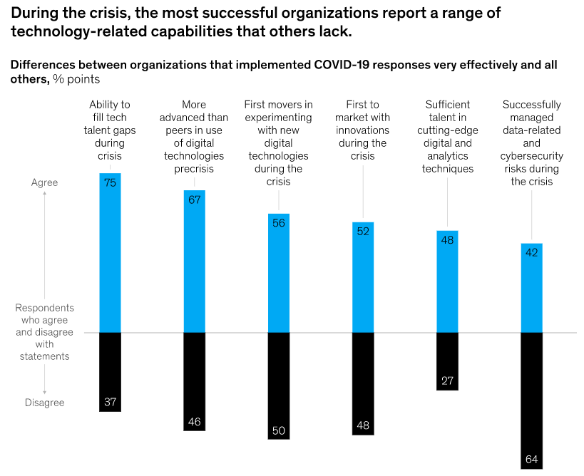
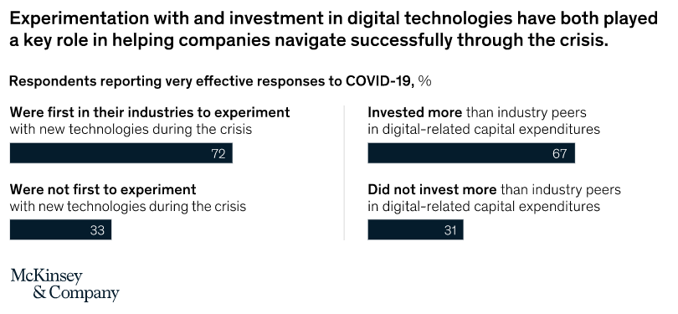
Early Adoption & Success

Slide 33
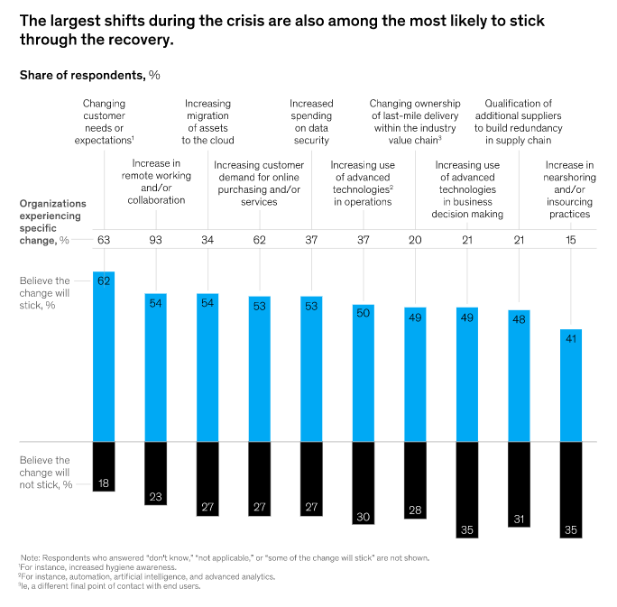
What’s Here to Stay?

Slide 34
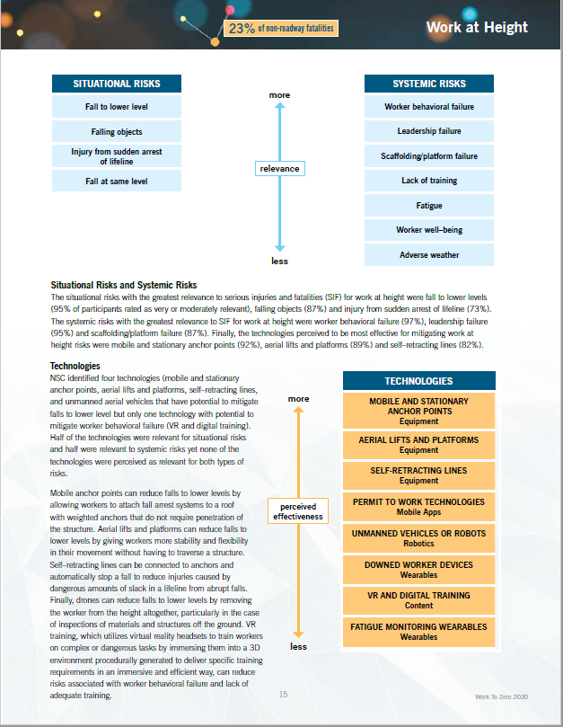
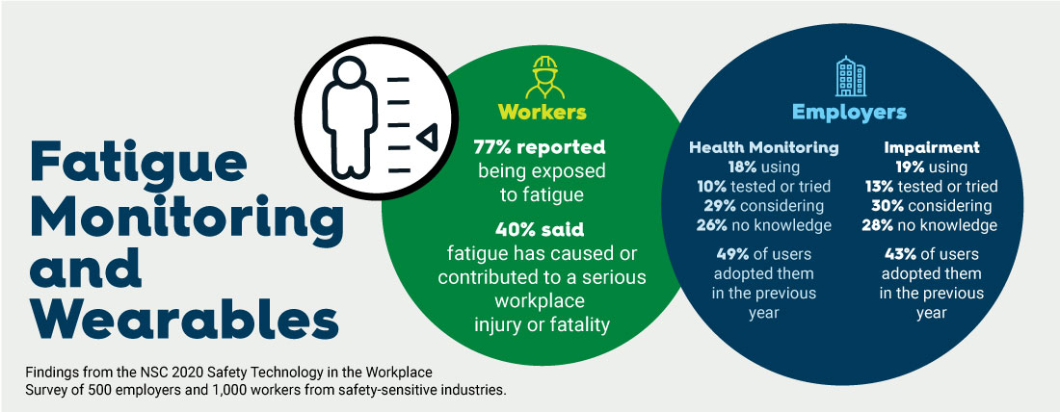
Tools & Resources

Slide 35
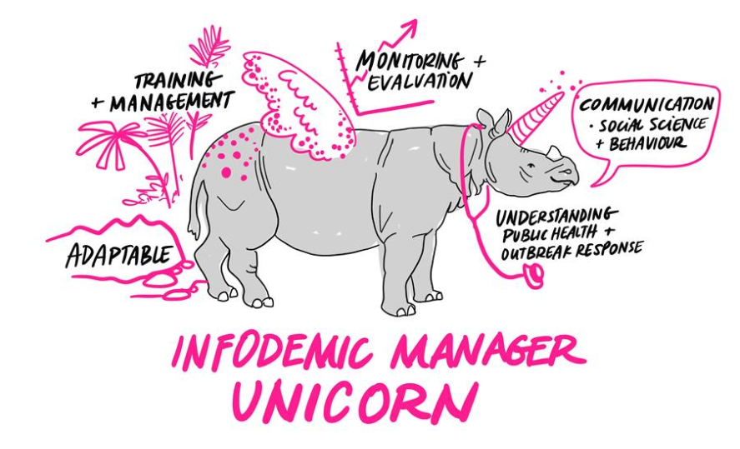
Omicron Update: The Infodemic
The evolving, uncertain circumstances of the COVID-19 pandemic created the conditions for what the World Health Organization (WHO) has termed an ”infodemic”: “an over-abundance of information – some accurate and some not – that makes it hard for people to find trustworthy sources and reliable guidance when they need it”
Source: World Health Organization

Slide 37
So What?
Takeaways for EHS
Where Do We Go From here?

Slide 38
Takeaways for EHS – The Positives & Negatives
Positive Trends
Spotlight on safety & health
Value clearer than ever
Expanded roles & responsibilities
Willingness to innovate
Unique position to transform organization
Possible Pitfalls
Role confusion & dilution
Change management challenges
Sustaining the momentum
Interconnectedness & complexity
The unknown unknowns

Slide 39
Where Do We Go From Here?
Existing Tools
SAFER: Wide variety of regularly-updated content and risk assessment tools
Work to Zero: Technology Cost Calculator(s)
NSC Perception Survey modules (COVID, Psychological Safety)
Upcoming Research
Campbell Institute: Psychological Safety, Leadership & Culture
SAFER: “Future Preparedness” Report, Issue Papers
ESG & The New Valuation of Safety & Health

Slide 40
Current State of COVID
SAFER Survey Results
Organizations & Workers

Slide 41
2021 NSC SAFER Surveys
SAFER Organizations Survey (n = 302)
Control measures
Vaccine policies
SAFER Workforce June Survey (n = 2,403)
Perception of employer’s pandemic response
Vaccine hesitancy
Consider the needs of populations of focus
SAFER Workforce July Survey (n = 1,382)
Vaccine hesitancy, boosters
Notes:
So far, SAFER has fielded three nationwide surveys of organizations, and four nationwide surveys of workers, beginning in June 2021
Over the summer, we fielded a survey of 300 organizations, and conducted interviews with health and safety professional from a wide range of industries to identify trends in the future of work
We also surveys over 3,700 American workers about their employer’s pandemic response, vaccine policies, and vaccine hesitancy

Slide 42
NSC SAFER Pulse Surveys
Monthly Organization Survey (n = 300), December 2021 through Spring 2022
Vaccine requirements
Monthly Workforce Survey (n = 1,000), December 2021 through August 2022
Vaccine hesitancy, boosters
Vaccine misinformation
Notes:
In December 2021, we began fielding monthly nationwide surveys of organizations and workers to monitor trends
Organizations:
Monitor trends in vaccine policies and vaccine uptake among workers
Monitor effect of federal regulations
Workers:
Monitor vaccine uptake and hesitancy, including boosters
Evaluate effects of employer vaccine policies
Study vaccine misinformation prevalence, and impact on vaccine uptake and hesitancy
Identify best practices for encouraging work vaccine uptake and to get their children vaccinated

Slide 43
Control Measures
Notes:
Over the summer, our surveys of organizations and workers studied the perceived effectiveness of control measures in the workplace, along with actual correlations between control measures and case rates
Research on the transmission of the novel coronavirus have found that the greatest risk is airborne, as opposed to surface transmission. As expected, the most effective control measures appear to involve reducing air transmission, as suggested by (other) studies of control measures and physical presence of the virus in different environments, and the correlations we found between control measures and actual case rates
These (table) were the control measures which correlated most strongly with lower case rates:
Ventilation and filtration: Organizations with in-person workspaces that improved ventilation and filtration of air had dramatically lower case rates than those that didn’t, especially in closed industrial settings (workers may be moving around more than in an office, sharing or switching workspaces)
Reducing in-person interaction through remote work or space between shifts: For in-person workspaces where remote work was not possible, space between shifts was associated with a similarly low case rate
Testing: Testing at home was the most strongly correlated, with in-person testing at site entry coming in second
“Hygiene Theatre:” Despite these findings, when asked about the perceived effectiveness of measures, workers and organizations alike consistently rated measures aimed at surface transmission and more highly visible, tangible measures (e.g., Plexiglas barriers, surface sanitization, and hand sanitizer) as most effective
Long-term investment:
Some of these interventions (testing, improved ventilation, and space between shifts) may be more costly or burdensome to implement than things like masking or hand sanitizer
These measures were some of the least frequently implemented
With the dramatic reductions in case rate associated with these measures, they can be a worthwhile investment that will reduce infectious disease transmission long-term
As tests are becoming more available and less costly (e.g., covered by insurance), frequent testing is more feasible now

Slide 44
Control Measures
Considerations for continued pandemic mitigation and future infectious disease control
Evaluate and improve filtration and ventilation
Reduce in-person work and face-to-face contact
Discourage “presenteeism”
Workforce segmentation and contact tracing
Consider masks for flu season, especially in public-facing roles, and encourage seasonal flu shots
Require proof of vaccination for in-person work
Notes:
Going forward:
Examine air flow and filtration in your workspace, as consider improvements as a long-term solution to reduce disease transmission and bolster worker health and wellbeing
Reduce close contact
Consider permanent remote positions for workers where feasible
94% of companies surveyed by Mercer, an HR consulting firm, found that remote workers were as productive or more productive than they were in person pre-pandemic
The majority of remote workers prefer not to return to the office, and may help retain workers, or promote hiring (most companies interviewed by NSC were doing this, partially or wholly for this reason)
ASU study found that 66% of employers intend to offer more remote and flexible work conditions post-pandemic
Remote work arrangements are perceived by workers to reduce workplace discrimination and microaggressions, promoting a psychologically safe work environment
Discourage a culture of presenteeism, which not only reduces productivity for the sick workers, but for anyone they spread illness to
Encourage staying home while sick
Offer specific sick days (vs. using vacation time)
COVID-specific: Enforce isolation periods for workers who test positive, and require re-testing before return
Segmentation and contact tracing
Segmenting workers so that the same people work together each shift (e.g., in a restaurant or hospital where people are scheduled for different shifts with numerous people) to reduce contact between larger groups of workers
This contains possible exposure to smaller groups– Can help stop one positive case from sidelining a larger number of workers
Consider extending covid measures to stem infectious disease transmission in general, such as flu season
Require proof of vaccination (More detail on next slide)
35% higher vaccination rate in August for the 17% of workers required to be vaccinated
26% higher vaccination rate in December for the 32% of workers required to be vaccinated

Slide 45
Considerations for Vaccine Requirements
Implement a vaccine requirement policy, depending upon the level of risk of workplace transmission
Include regular boosters in vaccine requirement policies, and re-verify vaccination status when workers require booster shots in order to maintain full immunity
Make sure workers are educated about the vaccine
Make the vaccine easily accessible
Implement frequent COVID-19 testing for unvaccinated workers and consider screening testing
Notes:
Risk-based assessment for implementing vaccine requirements (spectrum of requirements on next slide)
Include boosters in requirement
Offers more protection
SAFER studies are finding that people who have postponed getting vaccinated until their were required are less likely to want to get boosters
Educate workers: Latest worker survey found that simply being shown fact-based information countering common vaccine myths (disinformation) significantly reduced vaccine hesitancy among the moveable middle: workers who were somewhat unlikely to somewhat likely to get vaccinated before being shown this information
Make the vaccine easily accessible, remove barriers: Workers who are given the time and support to make vaccination appointments, travel to appointments, or offered onsite vaccination at their workplace (← most effective and most requested by workers) are more likely to get vaccinated
If a worker can’t or won’t get vaccinated, implement the control measure associated with lowest case rates next to vaccination: regular and frequent testing
Consider screening testing of vaccinated workers to identify asymptomatic breakthrough infections

Slide 46
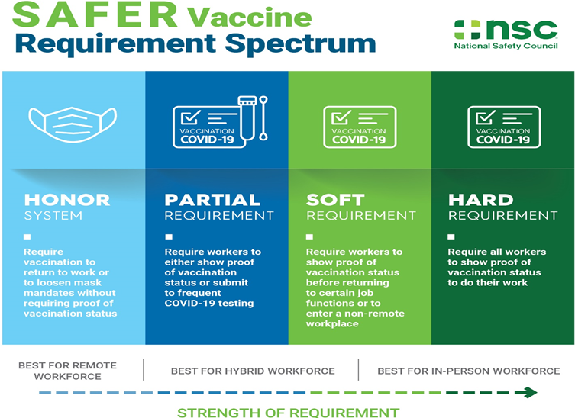
Notes:
Risk-based approach:
Consider what is best for your workplace based on amount of in-person interaction

Slide 47
Who is required to be vaccinated?
Notes:
Of employers currently requiring vaccination, about a third extend this to contractors, remote workers, or visitors
Consider extending vaccine requirements to contractors and visitors to further reduce risk to all workers and guests
Extending requirements to remote workers will help reduce overall risk in the communities where your workers and their families live

Slide 48
Expanding Operations
Labor shortages further exacerbate challenges for expanding operations:
Maintaining remote work arrangements helps retain workers
Reducing business travel, physical workplaces, and expanding remote work are the emerging trends among medium to large sized employers
Notes:
Many organizations interviewed and surveyed had hiring and retention as a top concern due to labor shortages (more about considerations for remote workers on next slide)
Future trends among organizations is expanding remote work and reducing business travel

Slide 49
Considerations for a Remote Workforce
Combatting “Zoom fatigue”
More frequent, brief interactions
Have “cameras off” or phone meetings
Reduce back-to-back meetings, and schedule breaks
Facilitate team cohesion
Empower teams to determine which collaborative work platforms work for them
Remote onboarding mentorship
Off site co-working space for in-person work or meetings when appropriate
Notes:
While the majority of workers prefer work from home arrangement and enjoy high productivity, here are some considerations for enhancing the health, wellbeing, and productivity/engagement of your remote workforce:
Combat “Zoom fatigue”
Video conferencing is more cognitively taxing than in-person meetings due to factors such as lag, the lack of hand and head movements that facilitate turn-taking, and the constant perceived eye contact between listeners
Reduce the length of meetings by replacing longer meetings with more brief, frequent interactions
Replace one-on-one meetings with phone calls, or encourage “cameras off” meetings
Limit meetings to 25 minutes or 50 minutes so that meetings are not back-to-back
Facilitate team cohesion
Utilize virtual collaboration tools that best suit the needs of different teams, and empower teams to choose the platform that best suits their needs
Pair new team members with a long-time team member to help ease a new hire’s transition into the new work environment
Encourage occasional, regular in-person work or meetings to allow teams to get to know one another (especially new team members) and communication styles, as well as facilitate more intuitive and less taxing interactions
(More about remote workforce next slide)

Slide 50
Considerations for a Remote Workforce
Promote health and wellbeing
Ergonomic training, and assessments of home offices
Promote work-life balance
Provide EAP resources
Notes:
Promote health and wellbeing
Ergonomic assessments
Implement virtual ergonomics training to empower workers to improve their physical workspace
Facilitate virtual one-on-one ergonomic assessments of each workers’ home office
Encourage early reporting of any symptoms of MSD, or other work-related injuries
Work-life balance
Encourage time-delay send for non-urgent emails outside of office hours, or to workers in other time zones
Make sure workers are aware of EAP resources available to them
Train managers and workers to recognize signs of burnout and adverse mental health outcomes, such as depression, or substance abuse

Slide 51
Future Crisis Resilience
Form a permanent crisis response team:
Monitor emerging threats and potential impacts to business operations
Consider how long-term threats, such as climate change, will affect safety and business operations
Empowered to bring recommendations for immediate or long-term actions to senior leaders without hesitation or apprehension
Notes:
Half of organizations that had a pandemic plan in place at the beginning of the pandemic found themselves unprepared (plan was inadequate) to respond to COVID-19
Forming a permanent crisis response team can help avoid future crises from causing major disruption
Consider long-term threats now: e.g., climate change, or emerging threats in areas of the world where your organization operates or sources supplies
These crisis response teams must be empowered to bring recommendations to senior leaders, so that advice can be acted on to proactively protect workers and the organization

Slide 52
Questions & Answers

Slide 53
Thank you! john.dony@nsc.org nsc.org
Notes:
Created by the National Safety Council, in partnership with industry leaders, leading safety organizations and public health experts.
Guide employers through the process of safely resuming traditional work and operations now and in a post-quarantine environment.
General and sector-specific playbooks are designed to help America's employers align worker safety with business objectives

